Slide 1
The Smart Ambulance Services
PIP104 PROFESSIONAL PRACTICE-II
VIVA-VOICE
Batch Number:CSE-G147
Roll Number | Student Name
20211LCS0016 20201CSE0778 20201CSE0776 20201CSE0724 | Mahammadanis M Sab ANAS AHMED Rayavarapu Sravan Ganesh
Under the Supervision of,
Dr. Prasad P S
Assistant Professor
School of Computer Science Engineering & Information Science
Presidency University

Slide 2
Introduction
When a life threatening accident requires an ambulance everyone wants the best care and the highest chance of survival on their journey to receiving advanced medical care. While proper training of ambulance workers can increase the success rate of trips, advancing the technologies that allow them to work safer and more efficiently provides a foundation for the advancement of the ambulance ride. Improving ambulance patient safety while simultaneously increasing the enroute capability of the ambulance through technological advancement allows engineers a unique opportunity to increase the lifesaving capabilities of ambulances worldwide.
The most important part of an ambulance ride is the safety of the crew and patients with a focus on delivering the patient to the professional care they require. While ambulances are designed to make this as easy as possible there is room for improvement in certain areas of their performance. Improvements could increase the ability of the ambulance crew to provide a high level of care and perform all the necessary treatments to insure that the patient arrive at advanced treatment facilities. Once these areas in need of improvement have been identified, potential design flaws are attributed to the poor performance characteristics of the ambulance so that an engineering solution may be applied.

Slide 3
Introduction
Determining how the desired improvements may be realized an engineering problem statement is formed outlining what is to be done. First the current safety issues and patient comfort problems associated with ambulances must be established. By consulting records on ambulance accidents and fatalities along with questioning current EMT personnel issues, preventing the best possible patient care may be identified and investigated further. These issues will allow current ambulance design to be analyzed highlighting potential areas for 8 improvement. A physical design flaw derived from the need to improve a current area of patient care gives engineers the problem statement to which potential solutions and designs may be theorized and ultimately realized to resolve the issue.
Without any unifying research done, concluding the problems associated with ambulances and the level of patient care they can accommodate, the most up to date source is the working population who use the current machines on a daily basis. To insure a thorough insight multiple sources were contacted; EMS technicians were polled online as well as in person at local emergency facilities, both paramedic supervisors and dispatch operators were interviewed, and tours of local dispatch and management facilities were conducted.

Slide 4
Literature Review
Paper Name: Towards Vehicular Sensor Networks with Android Smartphones for Road Surface Monitoring.
Authors: Girts Strazdins, Artis Mednis, Georgijs Kanonirs, Reinholds Zviedris and Leo Selav
Description: Android is one of the most popular smartphone platforms at the moment, and the popularity is even rising. Additionally, it is one of the most open and flexible platforms providing software developers easy access to phone hardware and rich software API. We envision Android-based smartphones as a powerful and widely used participatory sensing platform in near future. In this paper we examine Android smartphones in the context of road surface quality monitoring. We evaluated a set of pothole detection algorithms on Android phones with a sensing application while driving a car in urban environment.

Slide 5
Literature Review
Paper Name: Accident identification system with SMS notification
Authors: Supriya vidhate, mamta tadavi, manisha jagtap, rajratan janrao
Description: In today’s world highway accident have become a common occurrence. Many people die each year due improper medical care after the accident happen. There is no effective method by which the correct authorities can be informed in time so that the person’s life can be saved. We are designing such a device which will not only detect any accident that happens to the car but also inform the appropriate authorities immediately as soon as the accident occurs

Slide 6
Literature Review
Paper Name: Cloud Computing and Accident Handling Systems
Authors: Jabar H Yousif, Dinesh Kumar Saini
Description: An attempt is made to study the current issues of the cloud computing solutions for the life critical system- car accident systems in the Gulf region. Gulf region has high death rate because of car accidents and there is little or no proper accident handling facilities in the region.

Slide 7
Literature Review
Paper Name: Assessment of medication adherence app features, functionality, and health literacy level and the creation of a searchable Web-based adherence app resource for health care professionals and patients.
Authors: Seth Heldenbrand*, Bradley C. Martin, Paul O. Gubbins, Kristie Hadden, Catherine Renna, Rebecca Shilling, Lindsey Dayer
Description: Objectives: To assess the features and level of health literacy (HL) of available medication adherence apps and to create a searchable website to assist health care providers (HCP) and patients identify quality adherence apps. Practice description: Medication nonadherence continues to be a significant problem and leads to poor health outcomes and avoidable health care expense.

Slide 8
Research Gaps Identified
GIS role in Transport
Geographical Information System (GIS) is used for the storage and analysis of spatial information. GIS gives more emphasis on analysis of geographic information, in contrast with other graphic or management systems more directed at the representation of geographic data or its storage [Cowen, D.J 1988]. Today different disciplines use Information Technology(IT) to 17 process the geographic information (remote sensing, geography, civil engineering, cartography, topology, geodesy, photogrammetry, ecology, architecture, computer science etc) [Pons & Perez 2003].Transport networks are used for movement of people, goods, and energy. The features such as form, efficiency and capacity of these networks make an impact on our quality of life and improve our perception of the world. When GIS is applied to transport, this is more than just a sphere of application of their generic functionality [Thill 2000]. L.Downey, Deputy Secretary for Transportation said “We see the geographical Information Systems as a real opportunity to unify transportation planning with the vast data processing capabilities inherent to today’s technology” and also Xu(2000) said “telematics products and services for individual means of transport are based on the integration of digital maps, RDS/TMC ( radio data systems/ traffic message channels) for the transmission of traffic data, GPS(Global Positioning Systems) and GSM( Global System for Mobile Communications) for the transmission of travel data, and mobile telephone communications and other additional sensors are needed to collect travelling information in real-time”.

Slide 9
Research Gaps Identified
Global Positioning System
In India use of GPS/GIS technology in road and railway transportation can improve the efficiency of operations while at the same time it can make contribution to safety natural disasters and man-made disasters. GPS/GIS applications in the land transportation system are divided into four main categories that are as follows [Mintsis. G et al, 2004].
1. Vehicle fleet management
2. How GPS use in Data collection and mapping.
3. Incident management 23
4. Vehicle navigation systems

Slide 10
Research Gaps Identified
Limitations of GPS
After May 2000 Selective Availability (SA) has been removed, this was the main cause for errors during positioning. There are some problems with GPS based AVL such as in urban areas, there are big building that abstract the satellite signals. The GPS device receives poor quality of signals. Adding additional sensors with GPS devices can solve this problem. A GPS receiver takes several minutes to start (cold start) to achieve the MS location fix. In emergency services, it is considered to be major delay for many applications. Also the question of size, cost and power consumption are main cause of limitation.

Slide 11
Proposed Methodology
This proposed system aims successful booking of ambulance with required medical support both in the ambulance and from the hospital. This system enables to overcome the disadvantages in the existing system by providing the exact location of the patient through google maps along with patient’s vital information. In the present scenario sometimes the ambulance with better equipments and medical support system is booked for non-emergency cases such as shifting patient to home without knowing the requestor’s requirement. On the contrary in case of emergency, wherein ambulance with medical support is required a non-emergency type. Prior booking of ambulances can done for pregnant women, senior citizens or disabled patients, to help them reach the hospital conveniently. According to World Health Organization (WHO), in any city, there must be at least 1 ambulance on 80,000 people. However, when we speak of the national capital Delhi, the ratio is appalling. Currently, only 1 ambulance for every 1, 50,000 people is at work [3].
The proposed web application is designed to overcome these issues. First of all on the ‘User side’ while booking there is an option whether emergency or nonemergency ambulance is required. Further on the ‘Hospital side’ they will manage the ambulance requirement and with good driver. Here in the proposed system driver has no authority to refuse once he is deputed by the hospital for duty.

Slide 12
Proposed Methodology
A. User Side
Booking an ambulance for emergency services and non-emergency services.
Sending request all nearby hospitals.
Receiving the information and contact details of the driver from the hospital.
The IoT based sensors will keep updating the pulse rate and temperature of the patient whenever there is a variation to the doctor until the patient reaches the hospital and also help doctors monitor the patient status continuously.
Tracking of the ambulance
A. Authentication
Authentication is done by providing username and password for landing into app. User has to log in before using app and if user is not registered then he has to register first. He will have to fill all the details asked for first time and provide valid mobile number for verification. The registration form consists of user's name, username, password, blood group, date of birth, gender, unique identification number and so on. The user may have to submit a medical report at the time of registration but that is optional. If he has a medical report then he can upload it. After filling all the information of the registration, only then the registration will be successful.

Slide 13
Proposed Methodology
B. User Location
This module helps to provide current location, from where he is sending the request for ambulance.
C. Booking Request
This module carries the request which consists: Booking type (emergency or non- emergency), number of casualties, symptoms (for example: fever, cold, etc.), photo (user location's image for knowing the exact condition of the patient) and medical report (optional). If there exists a medical report which is not being provided at the time of the registration or there is a new medical report, then he can also upload it. It is necessary to take a photo for knowing what the condition of patient is plus it will also help in identifying the genuineness of the request. Later, he has to submit and his request that will go to all the nearby hospital. User has to wait until getting an alert of sending his request to all nearby hospitals is successful. If any hospital accepts the user's request, the same request will be removed for other hospitals. All the user's details will be visible to the hospital. According to requested parameters, hospital will send the ambulance to the user along with the driver's name and contact number to the user.

Slide 14
Objectives
An online ambulance booking system is designed to facilitate the process of booking ambulance services through digital channels. The primary objectives of such systems include improving convenience and accessibility for patients, providing timely response from emergency services, and Enhancing operational efficiency for ambulance service providers. The system can also help reduce the burden on emergency call centers, provide accurate invoicing, and improve record keeping and billing procedures.
In today’s fast-paced world, access to timely emergency medical services is paramount. The project’s primary objectives center around revolutionizing ambulance booking through an intuitive web application. By focusing on diverse ambulance types, scheduling convenience, payment integration, visual availability, and automated cancellation processes, our initiative aims to transform the landscape of emergency healthcare
The objectives of this project is to:
Booking ambulances with different types using our application web in your chosen location:
The cornerstone of this project lies in the seamless booking of various ambulance types through a user-friendly web application. By leveraging advanced technology, individuals can effortlessly navigate through different ambulance categories, catering to specific medical needs. Whether it's basic transport or specialized care, our platform ensures accessibility and choice in emergency situations.

Slide 15
Objectives
Helps to get all desired schedules.
Scheduling complexities often hinder prompt access to emergency services. Our project addresses this by streamlining the scheduling process, enabling users to acquire their desired ambulance schedules with ease. Through a user-centric interface, individuals can select preferred timings, reducing waiting times and ensuring timely medical assistance
Provide a single platform to book ambulance & do the payment
Centralizing ambulance bookings and payment procedures onto a single platform simplifies the often convoluted process. Our application eliminates the hassle of navigating multiple systems, providing a seamless experience from booking to payment. This consolidation promotes efficiency, transparency, and ease of access for users seeking urgent medical assistance.
Availability a pictorial representation of which s are still available could be seen.
Visual representation is a powerful tool in decision-making. Our project integrates a pictorial display showcasing the availability of ambulances. This intuitive feature enables users to visualize and select available ambulance slots, ensuring informed decision-making during emergencies. This graphical representation enhances user experience, making the booking process efficient and intuitive

Slide 16
Objectives
Redundant systems and canceled bookings often pose administrative challenges. Our project introduces an automated cancellation system to alleviate this issue. By leveraging automation, redundant bookings are efficiently managed and canceled, optimizing ambulance availability and ensuring resources are allocated effectively.
In conclusion, this project aims to redefine the paradigm of emergency medical services by introducing a comprehensive and user-centric ambulance booking platform. By encompassing diverse ambulance types, scheduling convenience, payment integration, visual availability, and automated cancellation processes, our initiative strives to enhance accessibility, efficiency, and reliability in emergency healthcare.

Slide 17
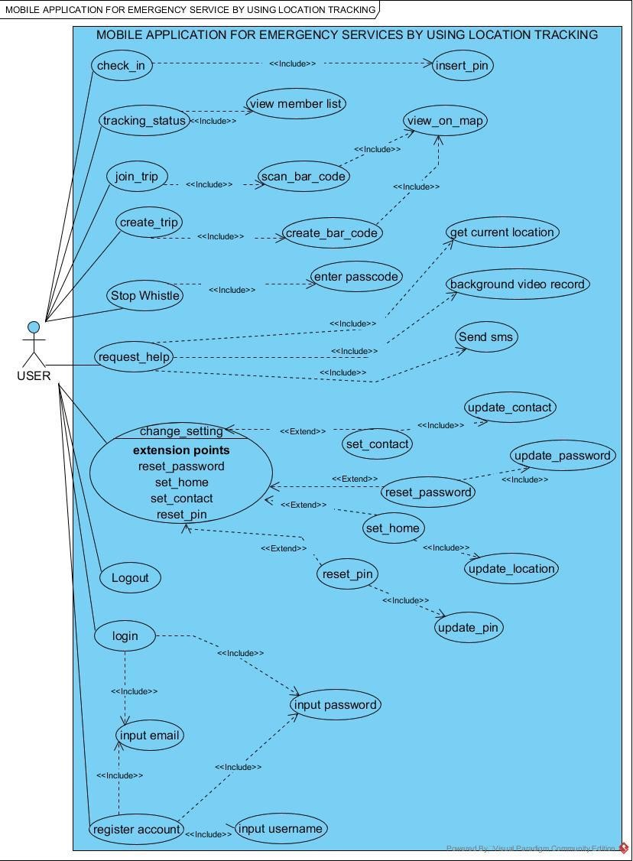
System Design & Implementation
USE CASE DIAGRAM
USE CASE DIAGRAM

Slide 18
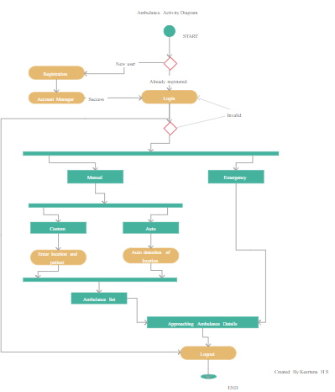
System Design & Implementation
ACTIVITY DIAGRAM

Slide 19
System Design & Implementation
Data Flow Diagram
Request service
ONLINE AMBULANCE SYSTEM
ADMIN
USER
Given Response
reports
Given response
Check the Availability
AMBULANCE

Slide 20
System Design & Implementation
LANGUAGES AND TOOLS ARE USED
HTML
CSS
JAVASCRIPT
PHP
PHPMySQLServer(XAMPP)
The necessary technical skills are manageable, and all of the technologies are publicly available. The ease of integrating these technologies and the time constraints of product development are matched.
The website will be hosted for free at first, but it will eventually be implemented in a premium web hosting environment with enough bandwidth. This application uses relatively little bandwidth because it doesn't have any multimedia features.

Slide 21
Timeline of Project
We have around 6 months to finish this web-based project, if we schedule the work properly. This project group consists of FOUR people, two of them will handle the designing and coding while the remaining three will handle the other project parameters. Therefore, if the project is well-planned, the allotted time will allow for its appropriate construction.
Project Initiation (Month 0-1)
Define project goals and objectives.
Identify key stakeholders and form a project team.
Secure funding and resources.
Market Research and Analysis (Month 0-1)
Conduct market research to understand the current ambulance service landscape.
Identify competitors and potential partners.
Determine target regions and demographics.
Concept and Requirements (Month 1-2)
Develop a concept for the smart ambulance service.
Define the technical and functional requirements.
Create a preliminary budget and project plan.
Technology Selection and Procurement (Month 1-2)
Choose the necessary hardware and software components.
Procure or develop the technology required for the service.
System Design and Development (Month 2-3)
Develop the smart ambulance service infrastructure.
Create a mobile app or web portal for users.
Integrate real-time tracking, communication, and data analysis features.
Perform initial testing and quality assurance.

Slide 22
Outcomes / Results Obtained
The Outcomes of an online system for reserving ambulances can have a big influence on a lot of different things.
Timeliness and Availability:
Improved Access: By enabling users to quickly and easily book ambulances using a web-based platform, it improves access to emergency medical services.
Timely Response: Allows consumers to request ambulance services quickly and avoids the usual delays associated with phone-based reservations, which leads to speedier response times.
Effectiveness and Resource Allocation:
Optimal Resource Allocation: By offering automated scheduling and real-time availability, the system may maximize ambulance utilization by making sure resources are used effectively.
Decreased Administrative Overhead: By automating booking procedures, employees may concentrate on more important work by bearing less administrative load.
Improved User Experience:
Convenience: Offers an easy-to-use interface for scheduling, paying, and monitoring, improving consumers' experiences while

Slide 23
Conclusion
These days, mobile or web applications are far more advantageous than any other system because everyone always has them at their fingertips.
People can open and access any application at any time, which makes online or mobile applications more useful in today's world. Therefore, it is a good idea to book ambulance services—both emergency and non-emergency—using an online or mobile application. When a patient is brought to the hospital, this application makes medical emergency services much more beneficial because it allows for prompt treatment or efficient medical care to be provided in the least amount of time due to the patient's symptoms, medical report, and biostatistics (heartbeat, pulse rate, and body temperature) that are recorded during booking.
The prototype we envisioned during the initial phase of the project has been successfully implemented and is up and running as a software application. This software application has been designed to meet the features mentioned earlier. The page designing has been done using HTML, CSS and PHP.

Slide 24
References
[1]. Rhythma Kaul More than 50% heart attack cases reach hospital late, Govt data shows, Hindustan Times, New Delhi March 10, 2017. Retrieved from https://www.hindustantimes.com/indianews/more-than-50-of-heart-attack-casesreach-hospital-late-govt-data-shows/storypenFdsewgGwpIwiQnRDoLJ.html
[2]. Road accidents in India 2018. Government of India, Ministry of road transport & highways transport research wing, New Delhi, www.morth.nic.in
[3]. Sarthak Khanna, “Ambulance Response Optimization”, International Journal of Computer Sciences and Engineering (JCSE), EISSN: 2347-2693, Vol. 7(6), pp. 281-286, Jun 2019.
[4]. Kotze J. M, “The role of the ambulance service as part of the health profession”, S Afr Med J., Vol. 78, Issue 6, p.320-322, 1990.
[5]. P. Iyappan, B. Nanthini Devi, P. Nivedha and V. Sayoojya, “Lisa-life saver”, 2019 IEEE International Conference on System, Computation, Automation and Networking (ICSCAN), Pondicherry, India, pp. 1-6, 2019.
[6]. TV Sethuraman, Kartik Singh Rathore, Amritha G, Kanimozhi G, “IoT based system for Heart Rate Monitoring and Heart Attack Detection”, International Journal of Engineering and Advanced Technology (IJEAT), ISSN: 2249- 8958, Volume-8 Issue-5, June 2019.
[7]. Rashmi A.Nimbalkar, R.A. Fadnavis, “Domain Specific Search Of Nearest Hospital and Healthcare Management System”, IEEE, 978- 4799-2291-8, 2014.
[8]. R. Vithiya, S. Karthika and G. Sharmila, "Detection, Monitoring and Tracking Of Survivors under Critical Condition Using Raspberry-Pi," 2019 IEEE International Conference on System, Computation, Automation and Networking (ICSCAN), Pondicherry, India, doi: 10.1109/ICSCAN.2019.8878711, pp. 1-5, 2019.
[9]. Yuanyuan Du, Yu Chen, Dan Wang, Jinzhao Liu and Yongqiang Lu, "An android-based emergency alarm and healthcare management system," 2011 IEEE International Symposium on IT in Medicine and Education, Cuangzhou, doi: 10.1109/ITiME.2011.6130855, pp. 375-379, 2011.
[10]. Pasha, Imtiyaz, Ambulance management system using GIS, 2006

Slide 25
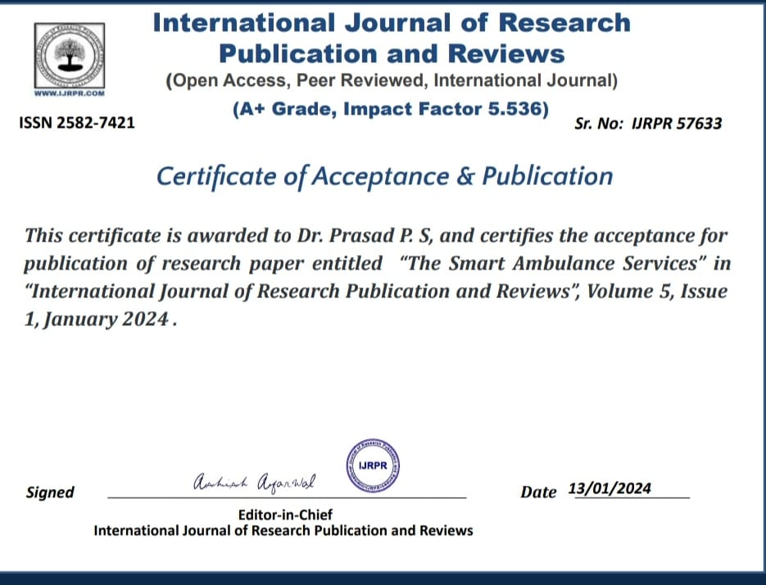
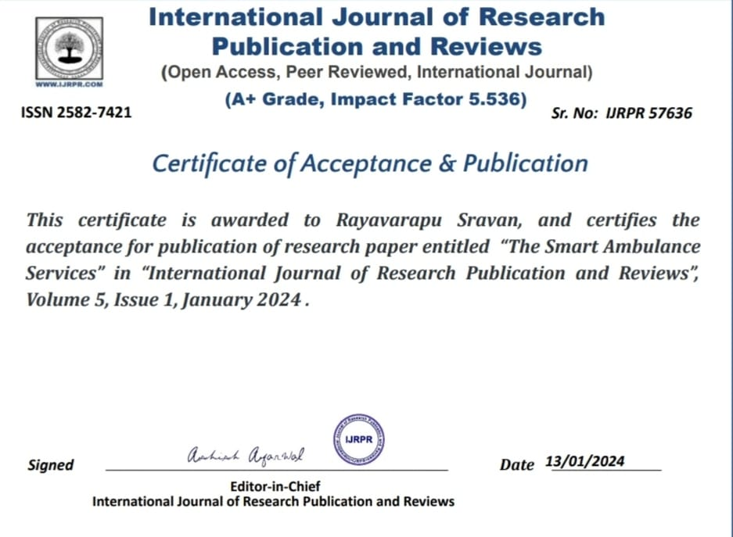
Publication Details

Slide 26
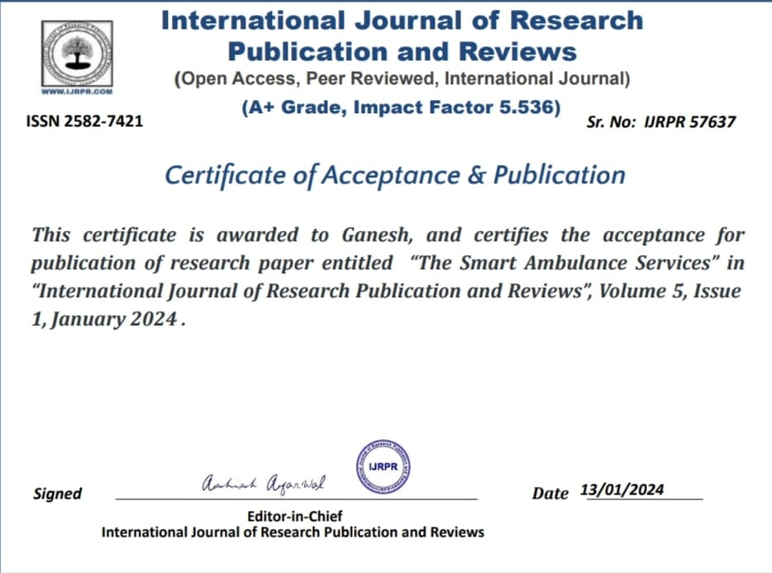
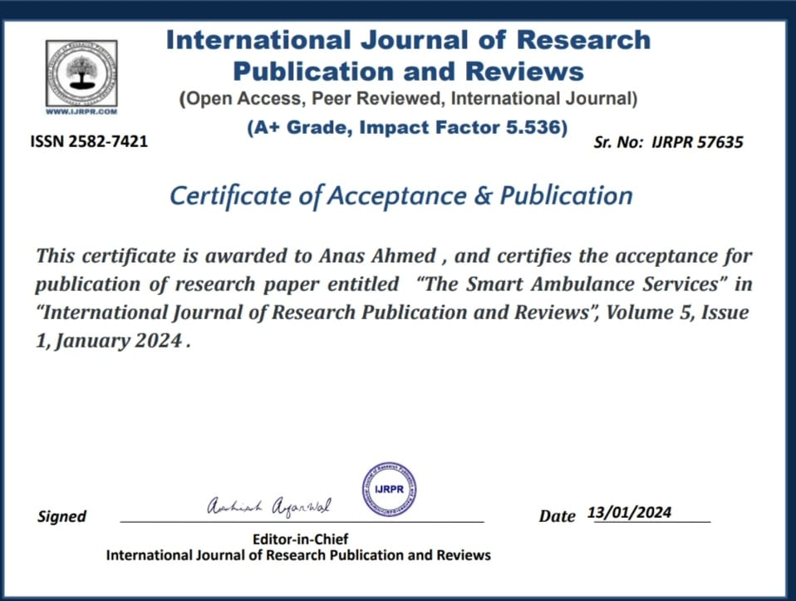

Slide 27
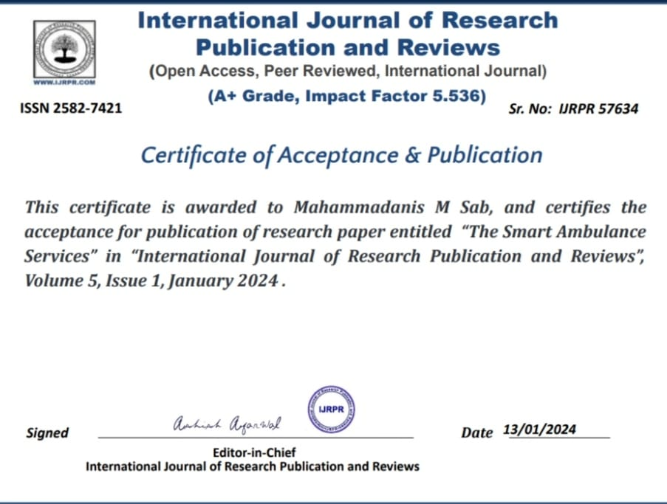

Slide 28

Thank You

